Slide 1
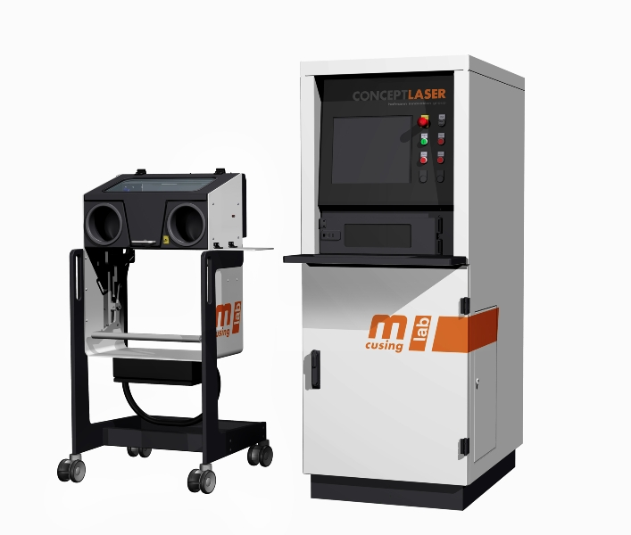
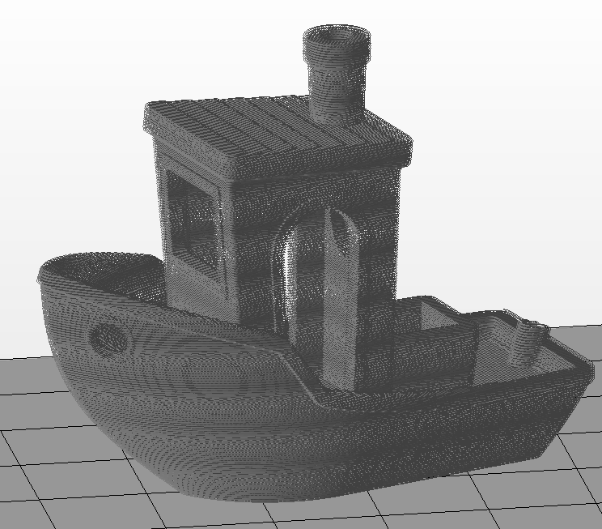
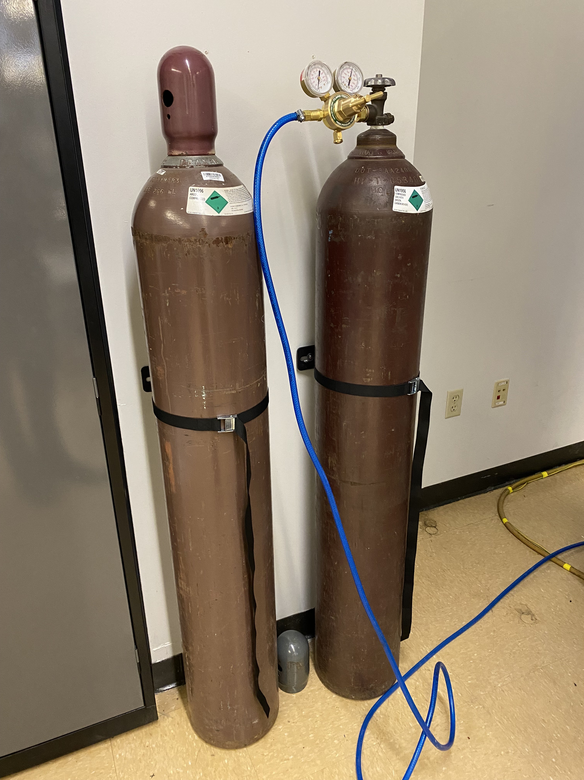
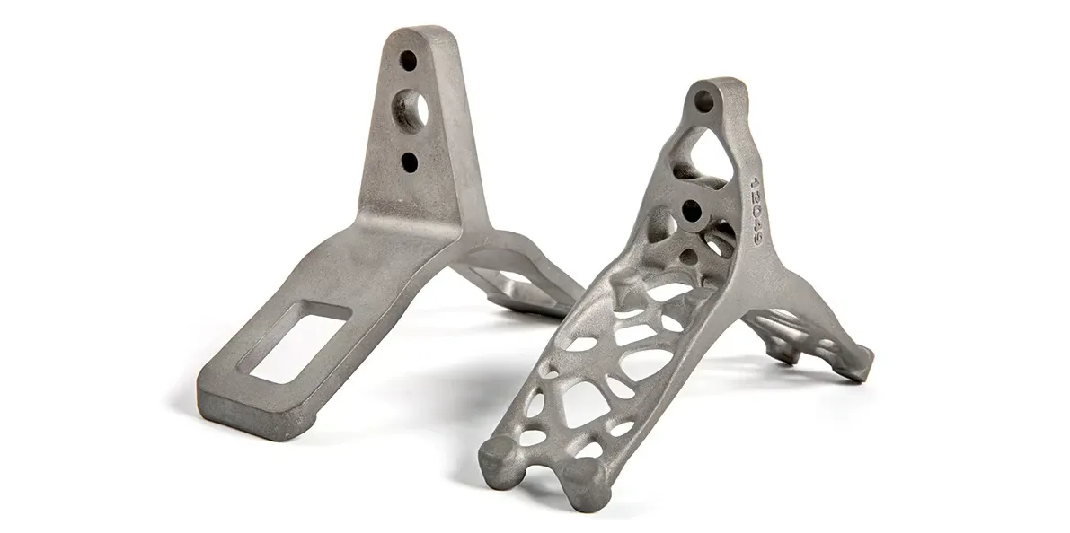
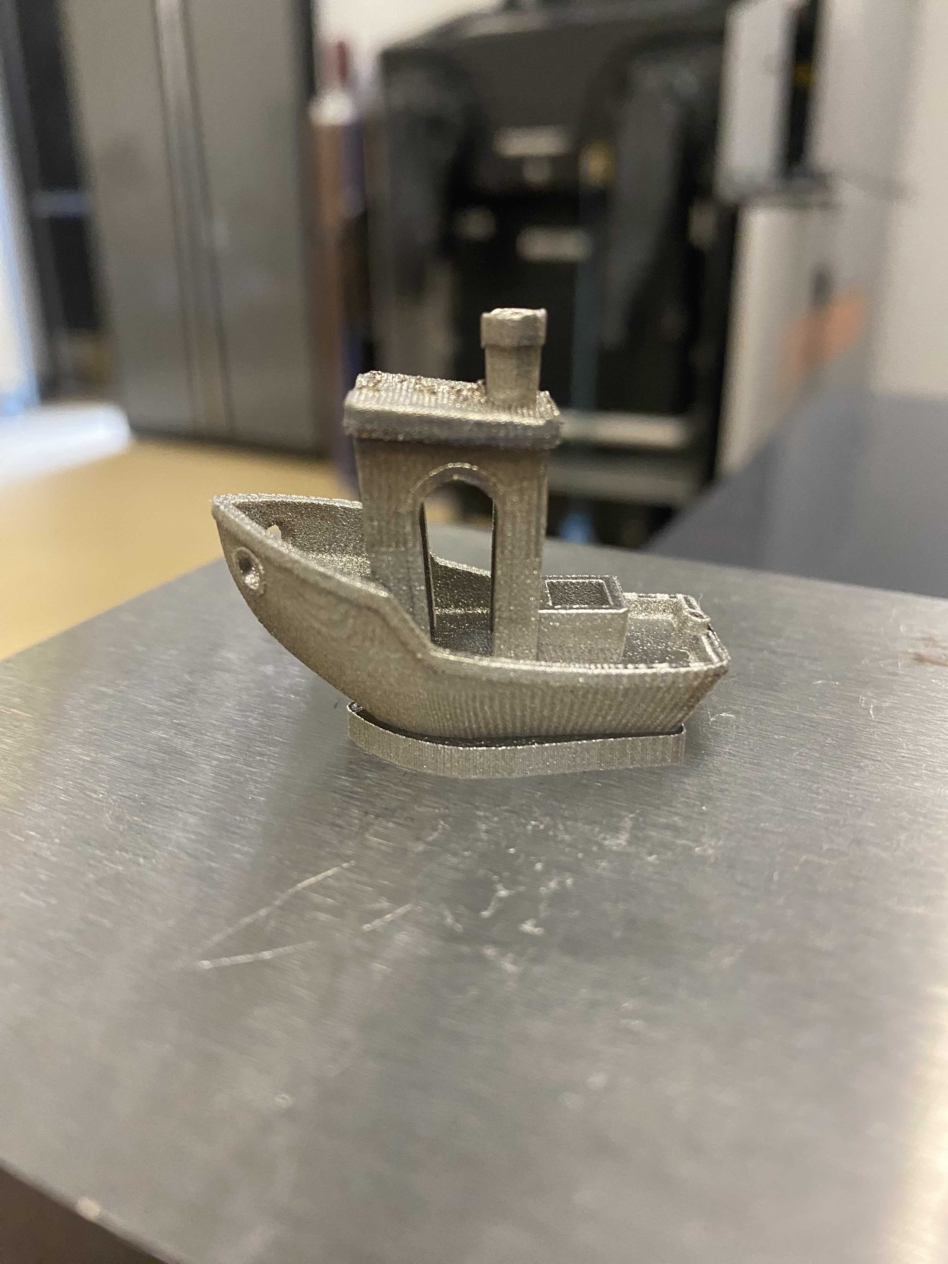
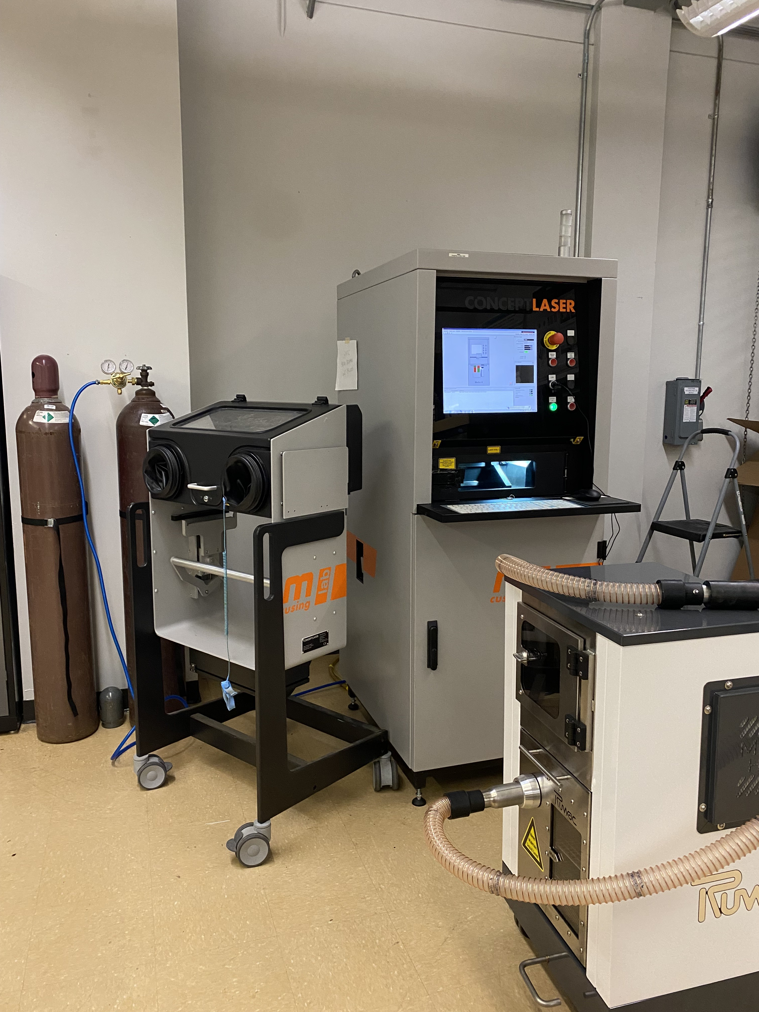
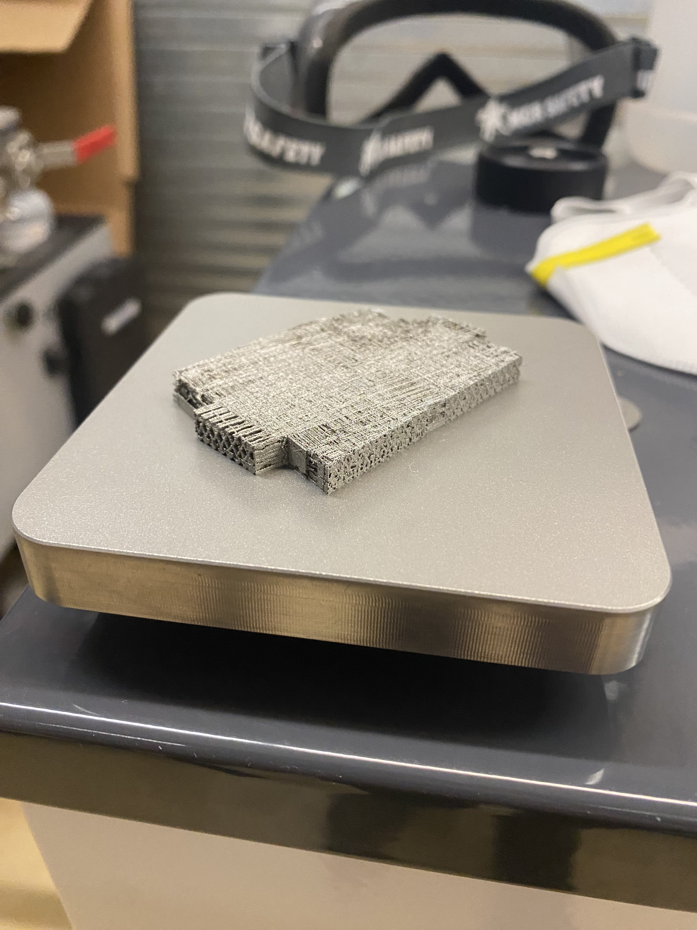
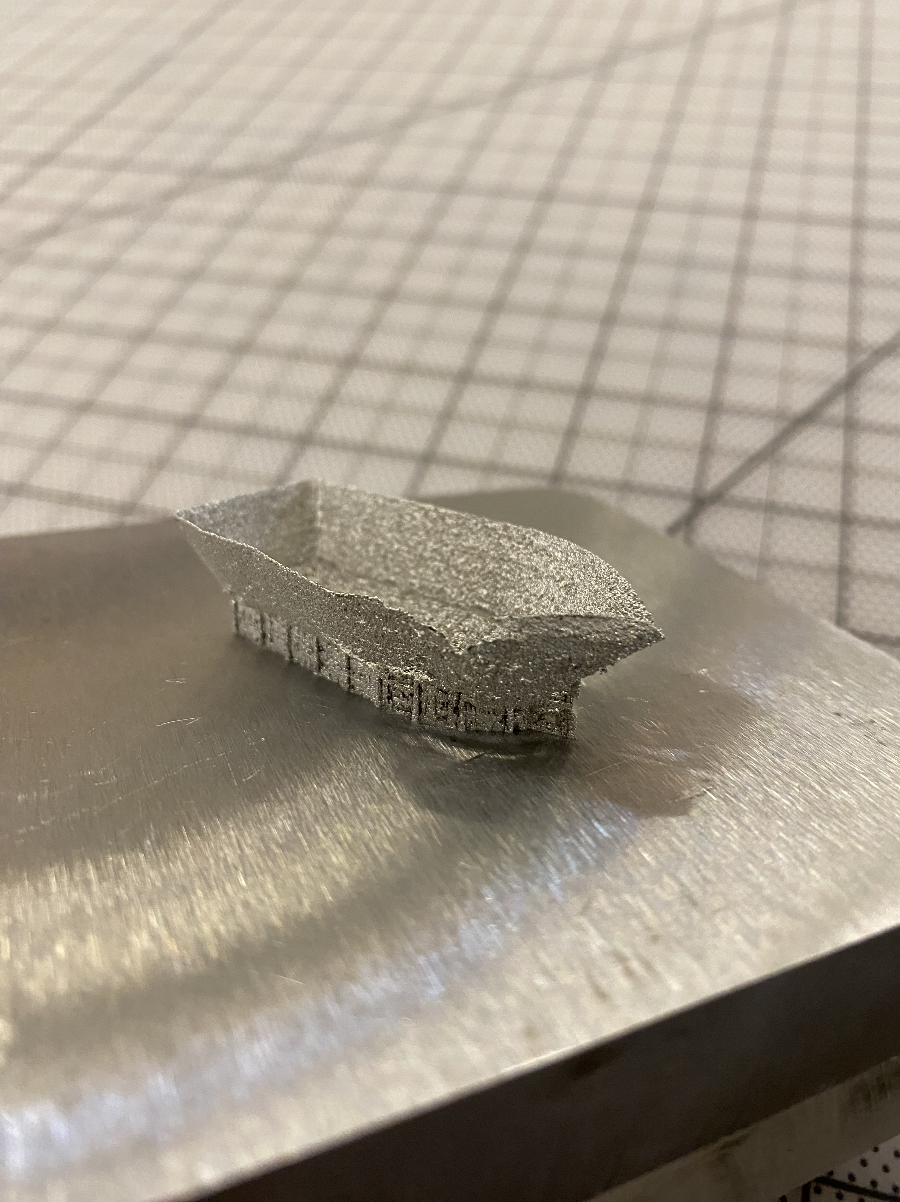
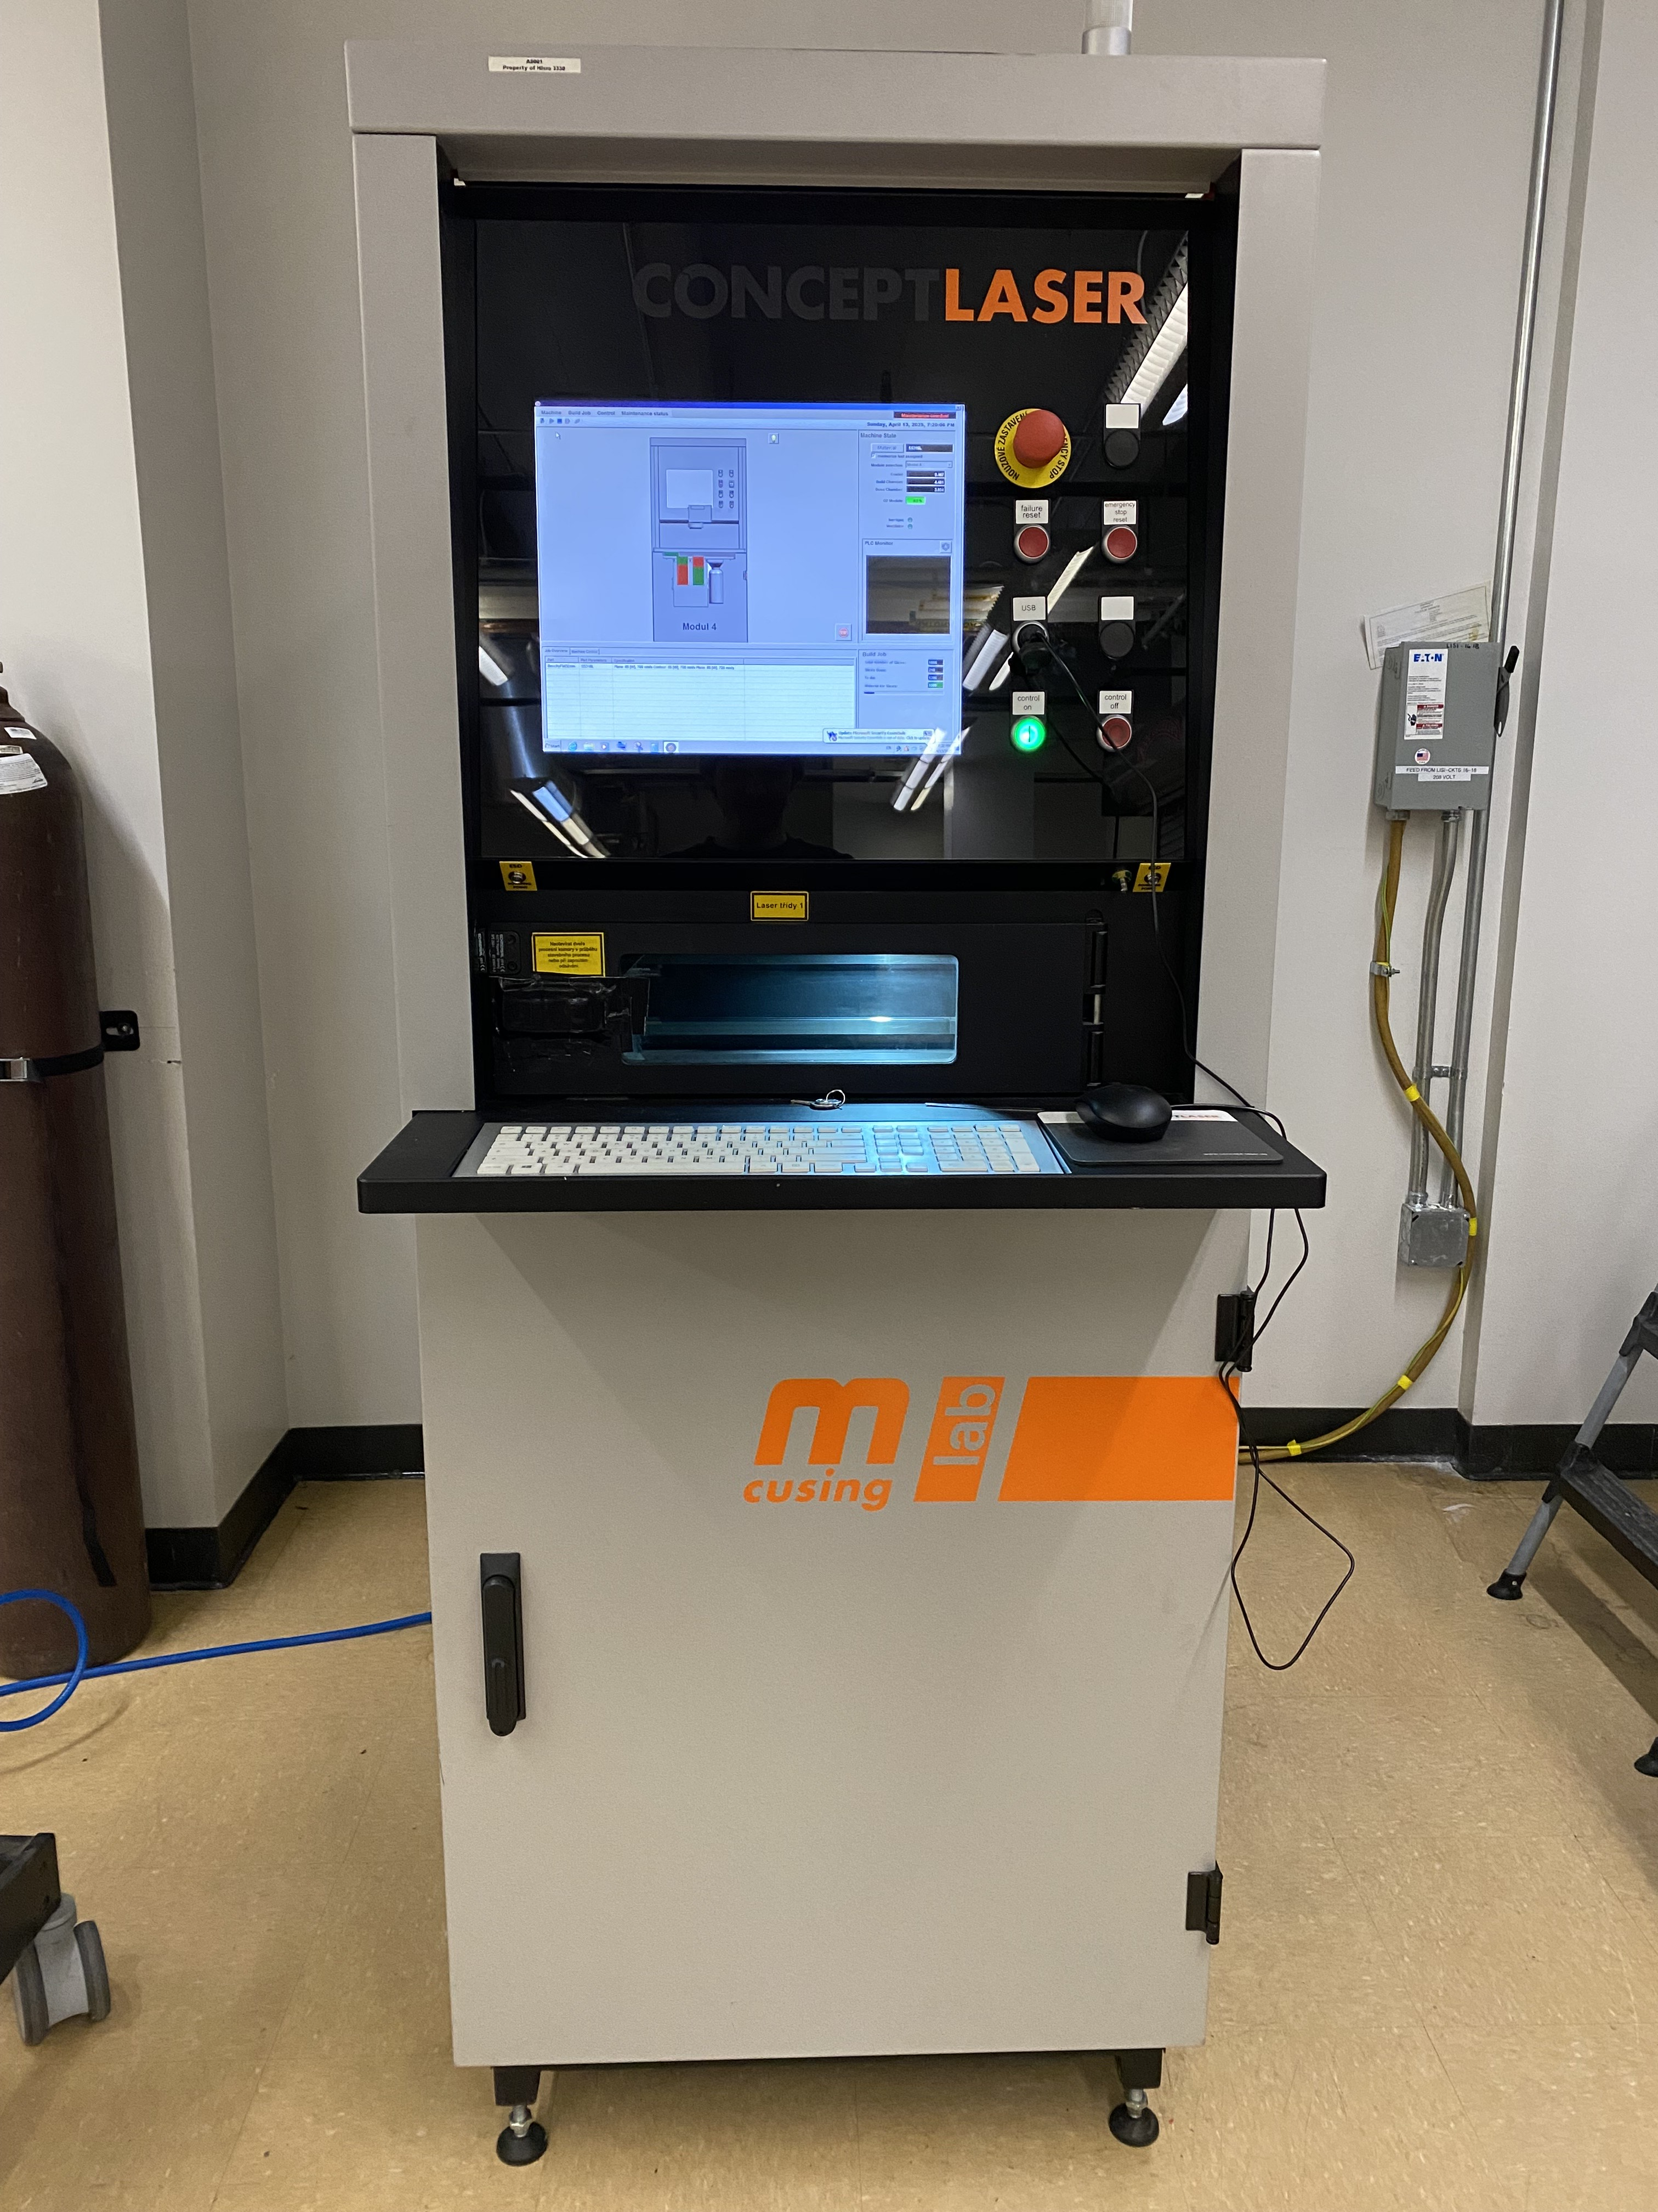
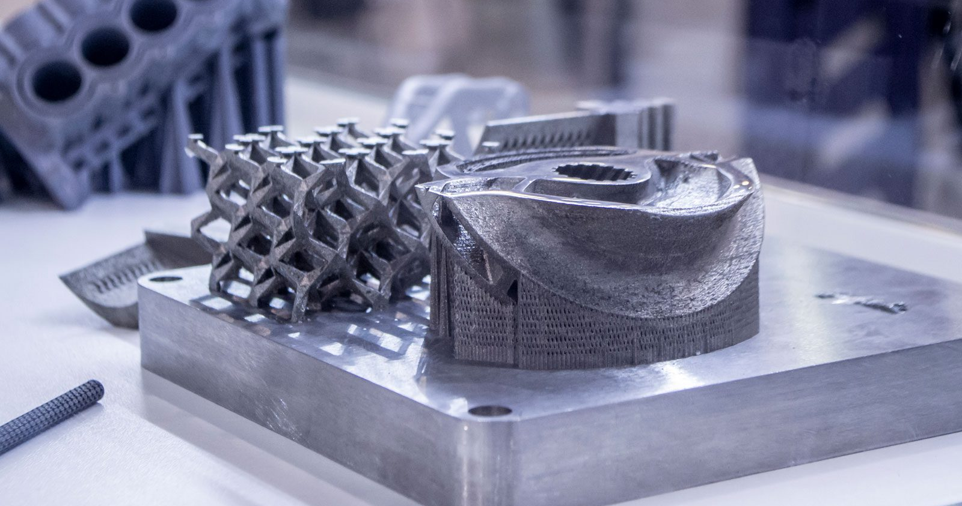
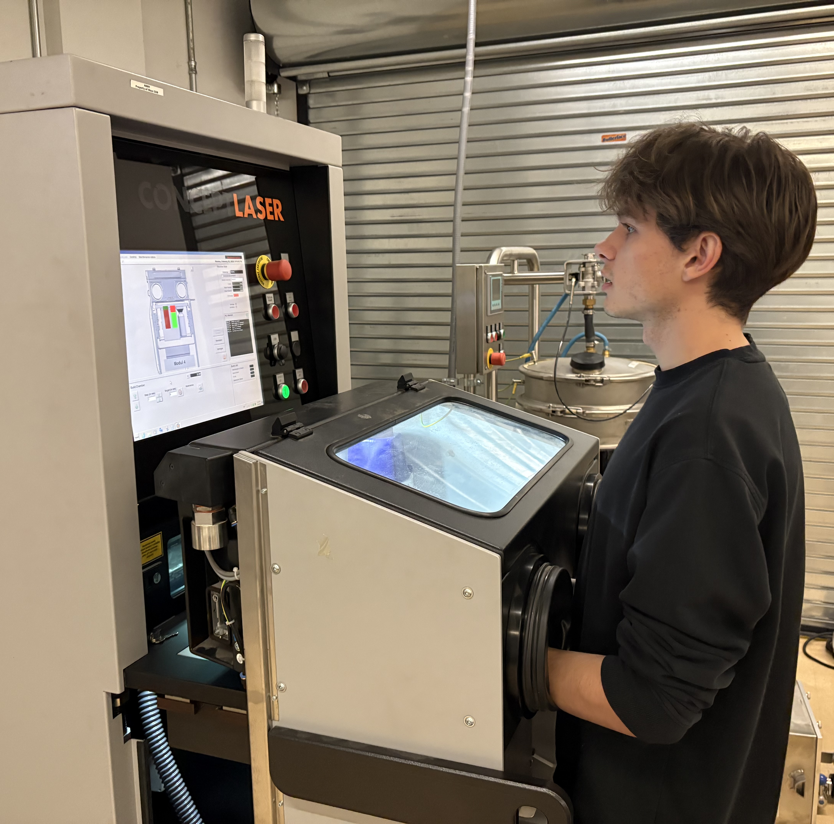
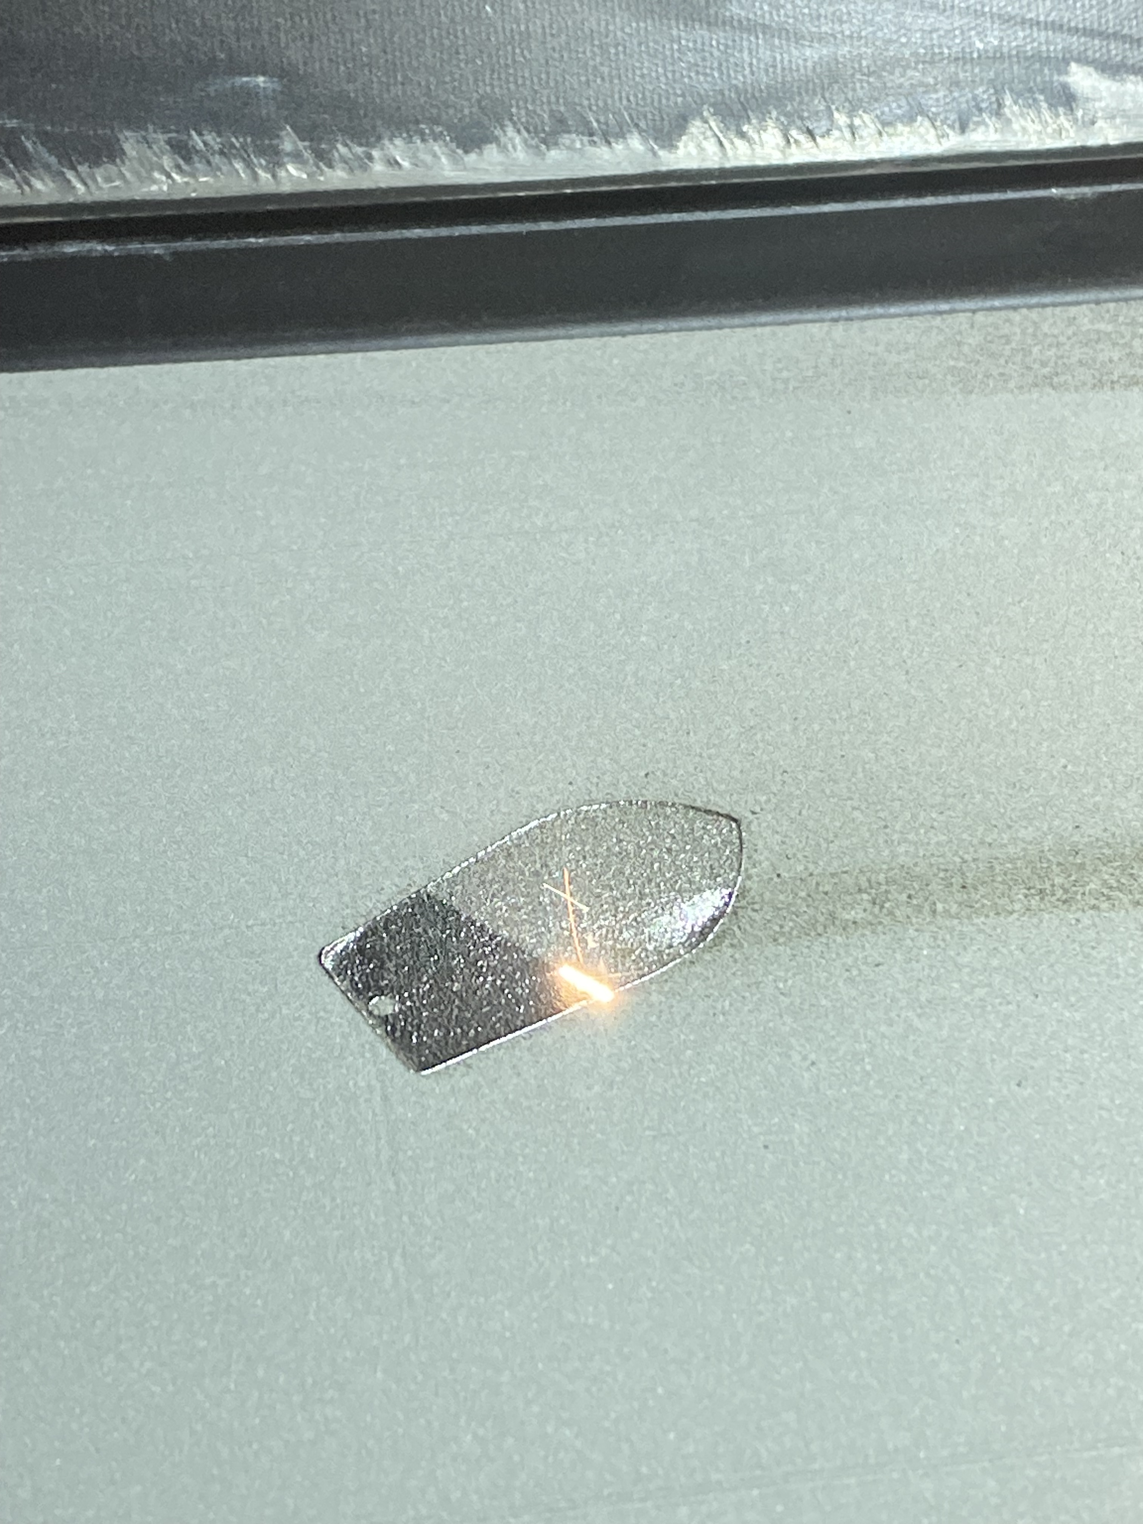
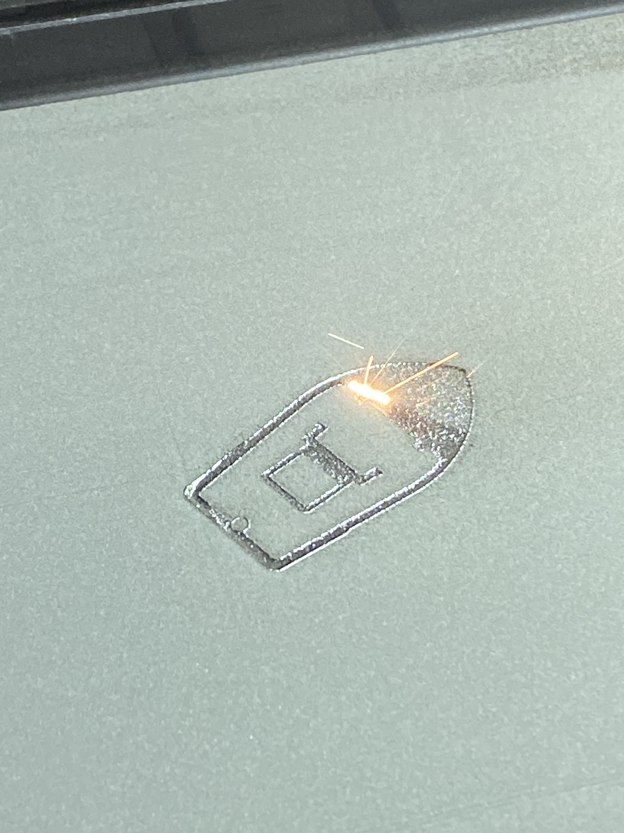
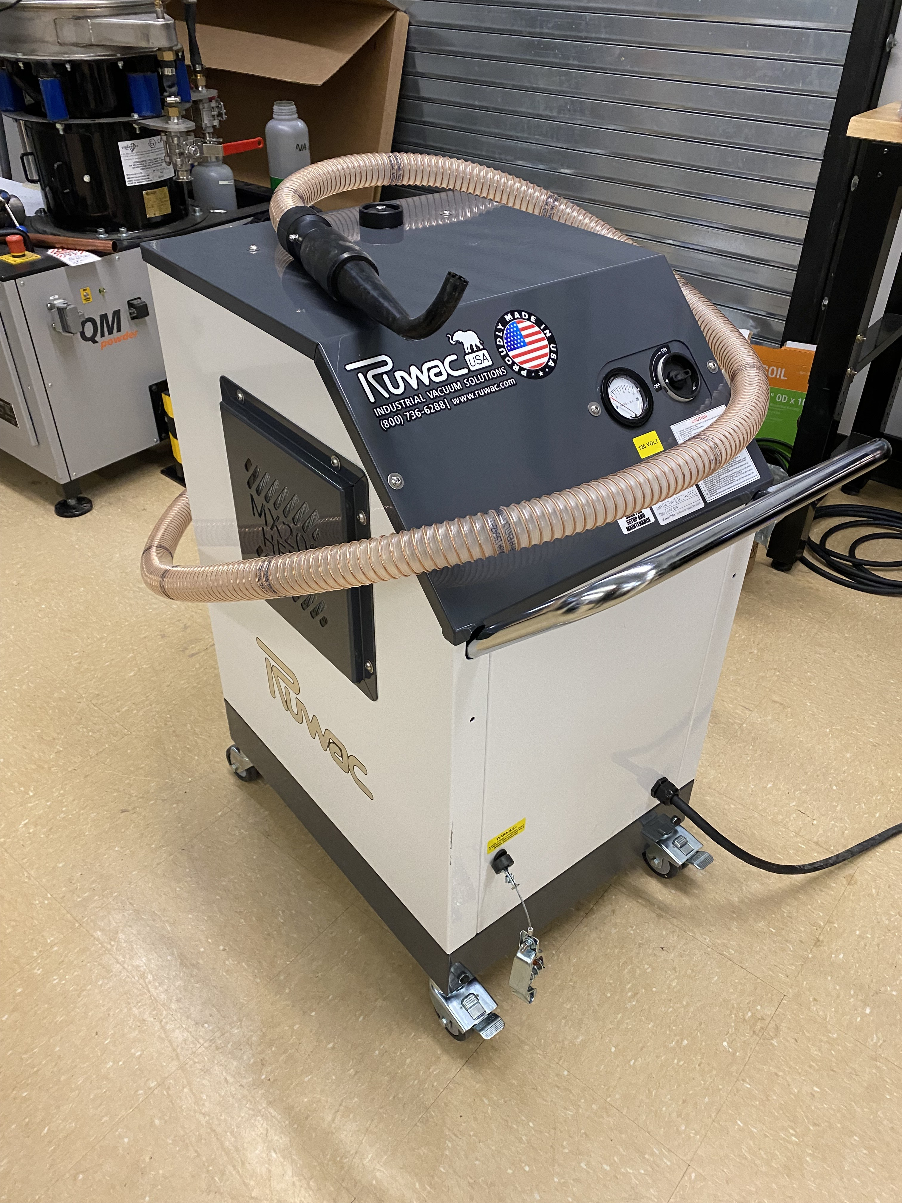
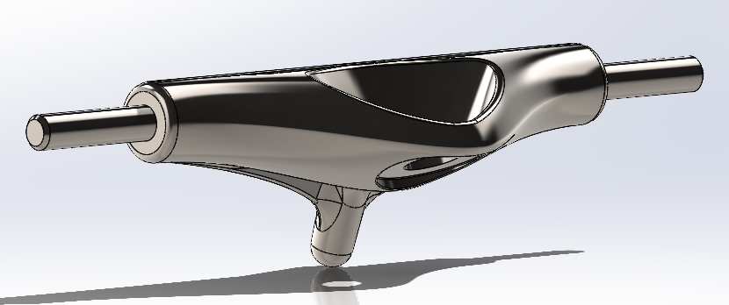
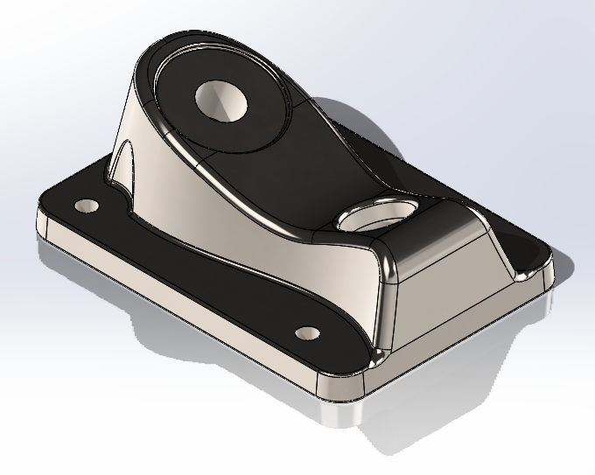
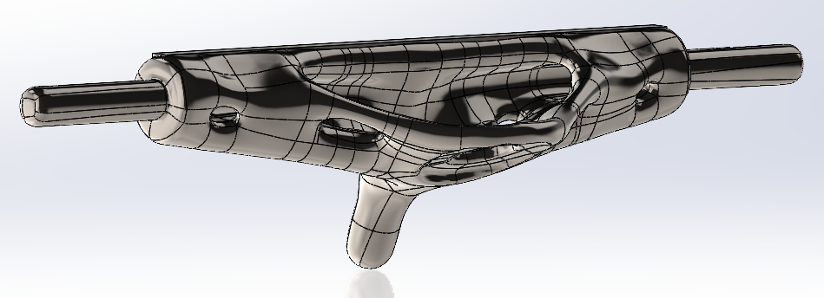
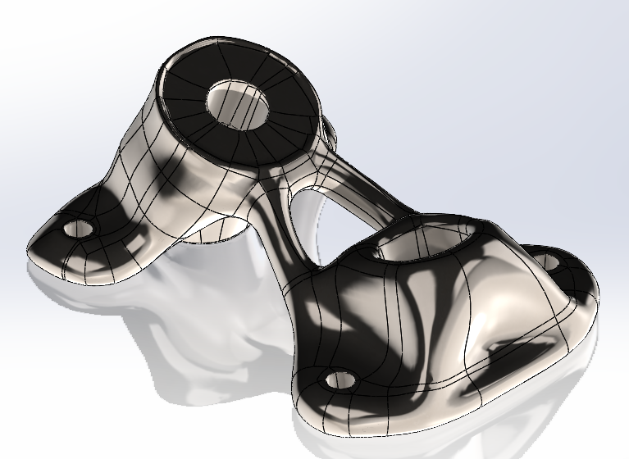
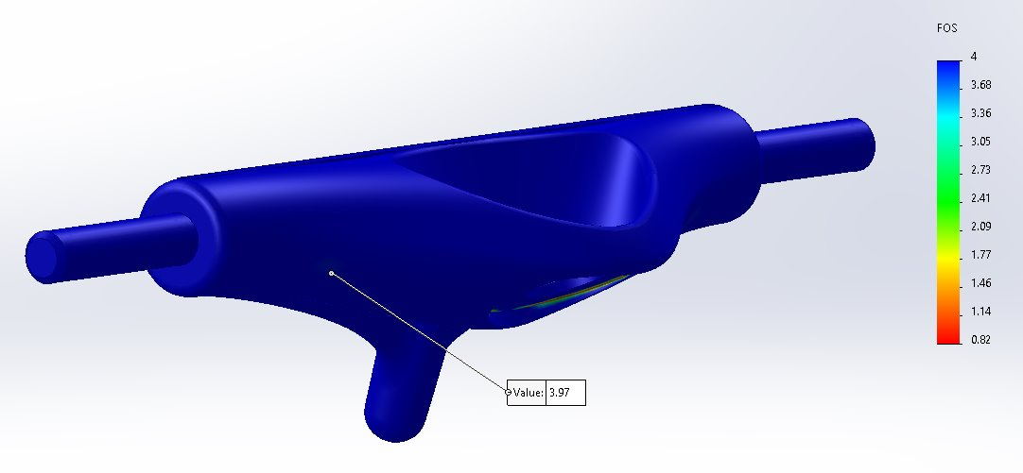
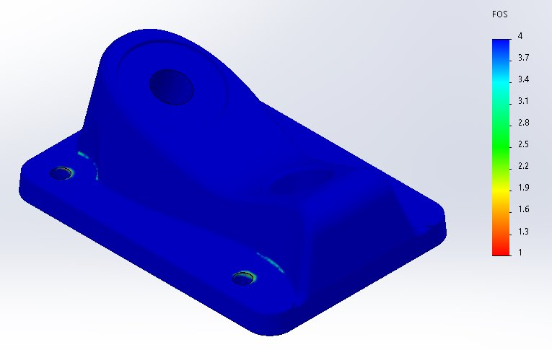
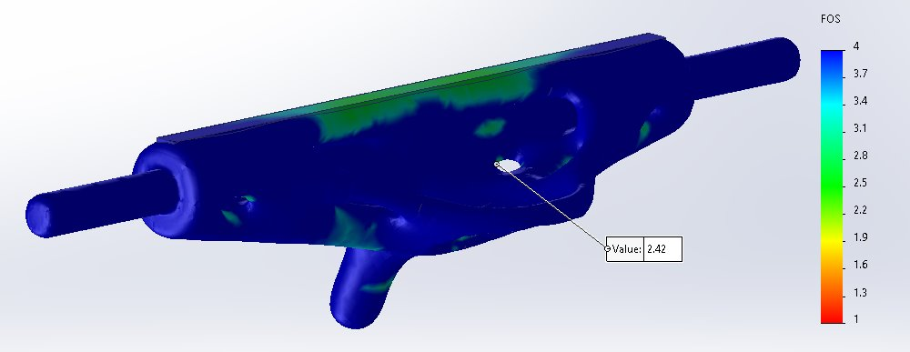
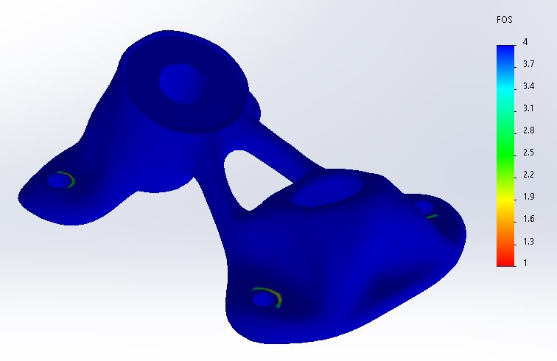
Commissioning a Laser Powder Bed Fusion Metal 3D Printer
Semester: Spring 2025
Steve Sanghi College of Engineering
Northern Arizona University, Flagstaff, AZ 86011
Nathan Krikawa
Nolan Hann
Abstract
Commissioning Process
Conclusion
This project involves the commissioning, testing, and initial operation of a Concept Laser Mlab Cusing R metal 3D printer, which was donated by Honeywell to Northern Arizona University's Mechanical Engineering department and is housed in the IDEA Lab. The primary objective is to have the printer fully operational by the end of the 2024-2025 school year, integrated into the ME286L manufacturing lab curriculum, and available for work orders from the IDEA Lab. The printer utilizes Laser Powder Bed Fusion (LPBF) technology, which fuses powdered metal into parts using a laser, and requires an inert environment provided by argon gas. For the purposes of this project, the team used 316L stainless steel powder. This is a safer metal than alternatives such as aluminum and titanium and was therefore ideal for testing. The first phase of the project involved installing and troubleshooting the printer, addressing issues such as build plate alignment and condensate leakage. Once functional, the team conducted tests comparing 3D printed and machined tensile test specimens, analyzed surface finish differences, and demonstrated the capabilities of additive metal manufacturing through a topology-optimized part. The project will culminate in the creation of a user manual and a training program to guide first-time users through machine operation and safety procedures, ensuring the printer’s integration into the IDEA Lab’s operations.
Research and Preparation: Research on machine operation and installation, including visits to the University of Arizona and Honeywell Aerospace’s Phoenix facility.
Power Connection: Installing power was a major hurdle, taking three months to achieve proper voltage supply to the IDEA Lab.
Argon Gas Procurement: Issues with suppliers and difficulties finding American-equivalent parts due to the machine’s German origin delayed the installation of argon gas, another roadblock.
Testing and Troubleshooting: We then began printing and troubleshooting, using the printer’s manual and research standards [1], [2]. We found gas leakage, build alignment issues, and model slicing for laser pathing to be our greatest hurdles.
Material Testing: After ensuring full functionality, tensile testing of printed specimens was conducted to compare the strength of 3D printed parts with traditionally Machined ones [2], [4].
The commissioning of the Mlab Cusing R metal 3D printer significantly enhances NAU’s manufacturing capabilities, enabling the production of complex metal parts that were previously unattainable with traditional machining Versatility: Capable of printing with various metals, including aluminum and titanium Impact: The printer will support capstone and research projects in the IDEA lab and contribute to the ME286 lab, enriching NAU’s engineering curriculum This addition positions NAU to advance in research and innovation across multiple disciplines
Results
Setup
Prints
Tensile Testing
Requirements
Customer Requirements | Description
Ease of Use | Accessibility of equipment, materials, and operation information
Safety | Clear and detailed operation procedure with relevant safety signage
Time | Printer fully operational by the end of the Spring 2025 semester
**Successful Installation | Fully installed and operational
Tensile Test Results | All test specimen tested; all results analyzed
Final Part and Assembly | Final part printed and assembled into greater assembly
Instruction Manual | “First print” instruction manual complete with comprehensive steps and files attached
References
[1] Hofmann Innovation Group. (2015). Concept Laser Operating Manual, Type: Mlab cusing R. Concept Laser. [2] Sutton, A. T., Kriewall, C. S., Leu, M. C., & Newkirk, J. W. (2016). "Powder characterisation techniques and effects of powder characteristics on part properties in powder-bed fusion processes." Virtual and Physical Prototyping, 12(1), 3–29. https://doi.org/10.1080/17452759.2016.1250605 [3] Sun, S., Brandt, M., & Easton, M. (2017). "Powder bed fusion processes: An overview." ScienceDirect. https://www.sciencedirect.com/science/article/pii/B9780081004333000026 [4] Bartlett, J. L., & Li, X. (2019). "An overview of residual stresses in metal powder bed fusion." Additive Manufacturing, 27, 131–149. https://doi.org/10.1016/j.addma.2019.02.020 [5] AddUp. (2023). "Surface Finish for 3D Printed Tooling: Advancing PBF Technology as a Production Tool | Blog." AddUp Solutions, October 5, 2023. https://addupsolutions.com/surface-finish-for-3d-printed-tooling-advancing-pbf-technology-as-a-production-tool-blog/
Skateboard Truck Topology Optimization
Engineering Requirements | Target
Materials Tested | One
Final Print Material | 316L stainless steel
Final Print Volume | 90x90x80mm
**Power | 240V, 16A
**Inert Gas | 2 bar Argon, purity >=2.5
Young's Modulus Tested | 193 GPa
Dog Bone Size | 65mm length
**Airtight Gas Supply | No audible leak
**Build Plate Alignment | Even material distribution
**Printed Part Tolerance | ±0.2mm
Using generative design tools, we optimized the mass distribution of a skateboard truck to minimize its weight while maintaining the structural integrity of the part. This design process creates very efficient, lightweight structures that are ideal for additive metal manufacturing. Topology optimization not only improves performance but also reduces material waste, making it a more sustainable and cost-effective solution for engineering applications.
Original Parts
 | Hanger Weight: 1.05lb Factor of Safety: 3.97 | Baseplate Weight: 0.87lb Factor of Safety: 4
Model
Factor of Safety Simulation
Topology Optimized Parts
 | Hanger Weight: 0.63lb (59.7%) Factor of Safety: 2.42 | Baseplate Weight: 0.46lb (52.4%) Factor of Safety: 4
Model
Factor of Safety Simulation
Acknowledgements
We would like to thank our instructors, David Willy, Connor Gaudette, and James Clark III, for their unwavering support and guidance throughout this journey. We are especially grateful to our external partner, Michael Downey, whose collaboration was essential to the project's success. We also appreciate Andrew Wessman for sharing his valuable knowledge. Finally, we thank Honeywell Aerospace for their generous donation of the machine and technical support, which made this work possible.

